Slide 1
Unsupervised Learning on Bank Marketing Data
Elena Conderana & Sergio Cuenca

Slide 2
Table of contents
01
02
03
04
05
Introduction
Exploratory Data Analysis
Principal Component Analysis
Clustering Analysis
Conclusions

Slide 3
01
Introduction

Slide 4



About the dataset
Demographic data, past marketing campaign responses
Complex relationships between consumer preferences and behavior
Influences in consumer engagement and loyalty

Slide 5



Problem vs Solution
Improving the efficacy of bank marketing initiatives
VS
One-size-fits-all tactics
More sophisticated, data-driven approaches

Slide 6
Table of contents
01
02
03
04
05
Introduction
Exploratory Data Analysis
Principal Component Analysis
Clustering Analysis
Conclusions

Slide 7
02
Exploratory Data Analysis (EDA)

Slide 8
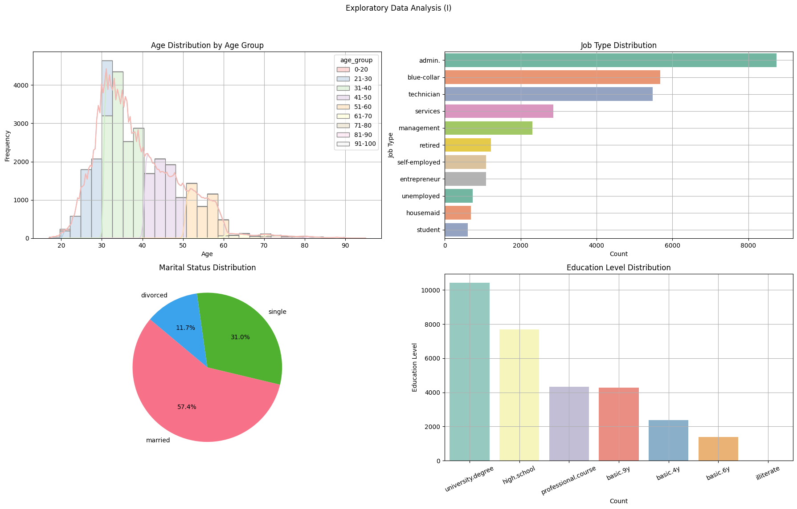
Insights Gained from Exploration
The prevailing age group ranges from 30 to 40 years of age
There are three types of job considerably more frecuent among the targeted audience (administrators, blue-collar workers and technicians)
The 25% and 75% percentile of the three jobs encaptures the 30 to 40 age group wholly. The same situation occurs with the education degree
The majority of the audience is in possesion of either a university degree or have finished high school

Slide 9
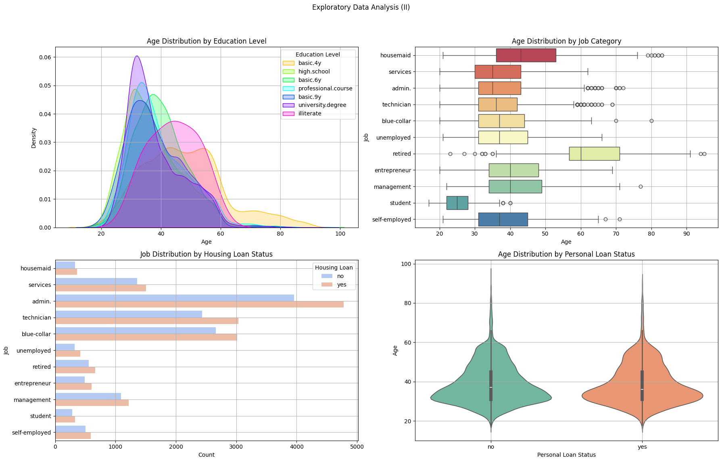
Insights Gained from Exploration
Either house or personal loans, the distributions even out. There is a very similar amount of people that have taken a personal loan and who haven’t.
House loans are equally frequent independent of the employment of each customer. There is evidently a higher density of house loans among technicians, administrators and blue-collar workers.
The prevailing trend is that more people do have a house loan.

Slide 10
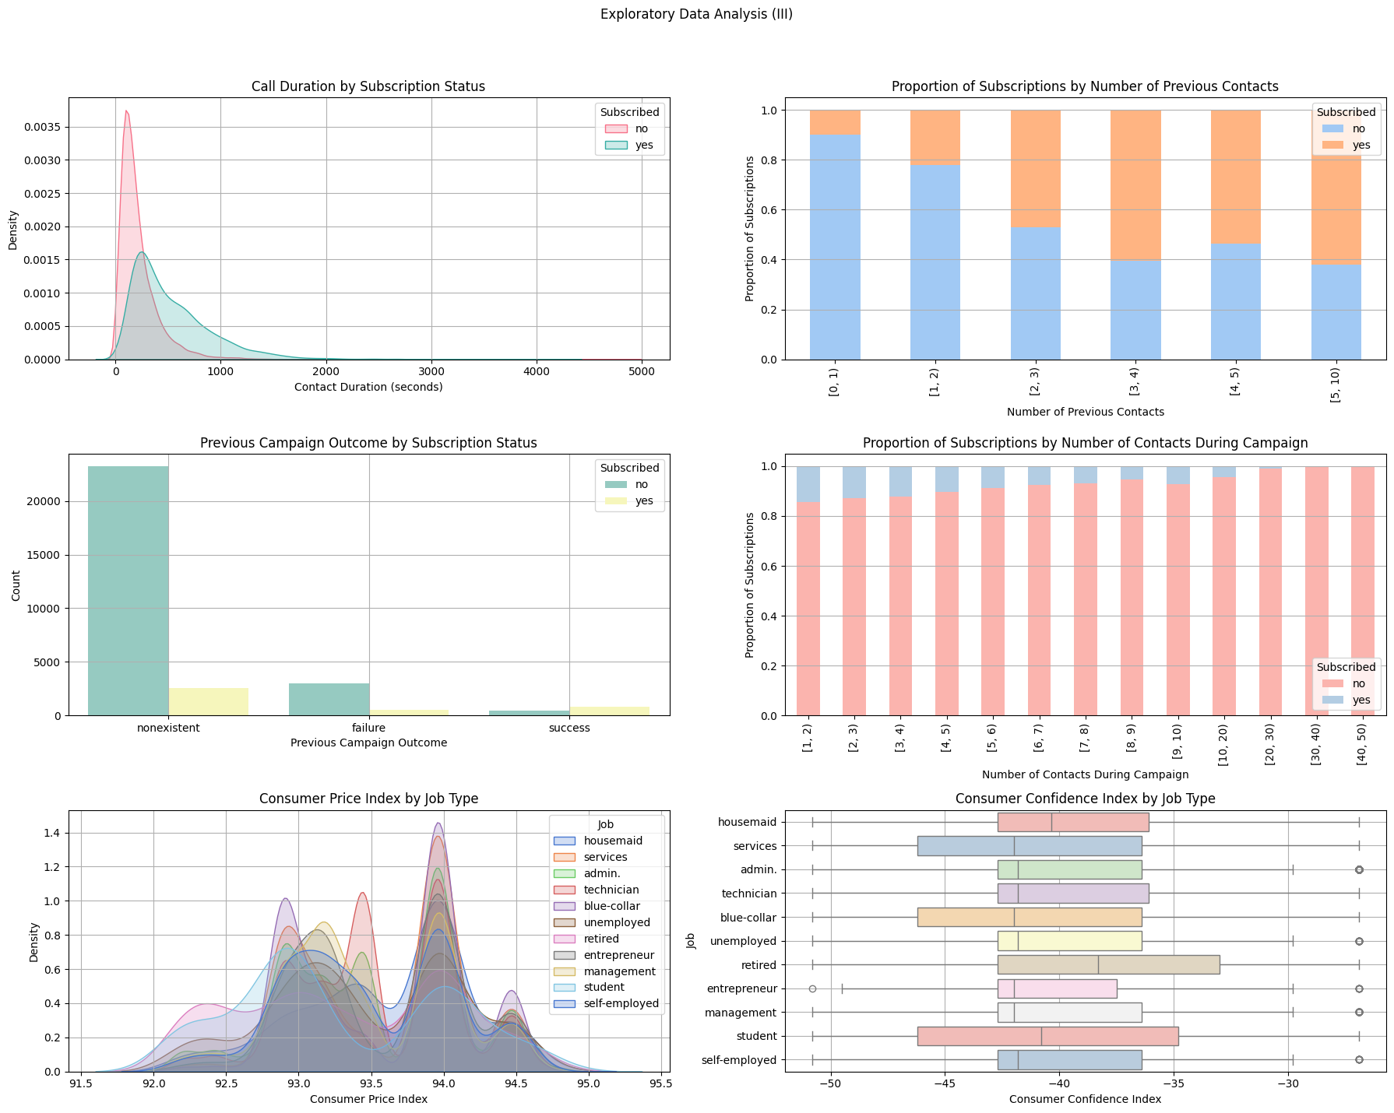
Insights Gained from Exploration
During the time previous to the campaign the more times the audience was contacted the more subscriptions there tended to be. This trend utterly switches during the campaign. During that time the more calls a person received, the less likely he was to subscribe a new deposit
Before the campaign 3 calls was an optimum amount to try to get a person to subscribe. During the campaign, however, if the second call had not succeeded it would be advisable to drop that customer and move towards the next
Calls with subscribed members or people that ended up subscribing have a tendency to have a longer duration

Slide 11
Table of contents
01
02
03
04
05
Introduction
Exploratory Data Analysis
Principal Component Analysis
Clustering Analysis
Conclusions

Slide 12
03
Principal Component Analysis (PCA)

Slide 13



Encoding
All features must be in numeric format. In order to encode all columns three different methods are used:
Ordinal
Binary
Nominal

Slide 14

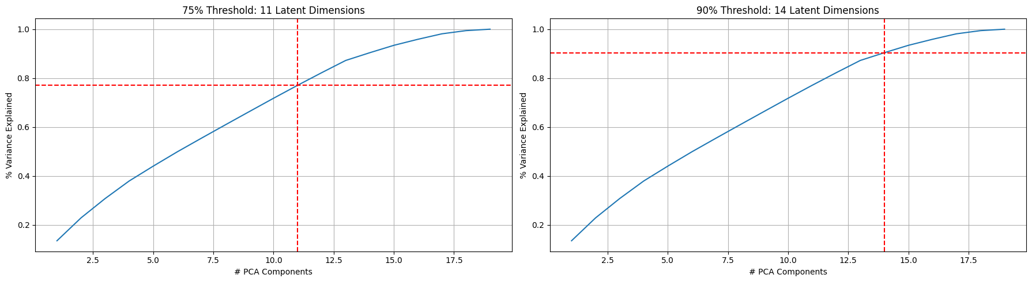
Kaisser Rule vs Explained Variance
VS
Kaisser Rule: 11 Latent Dimensions

Slide 15
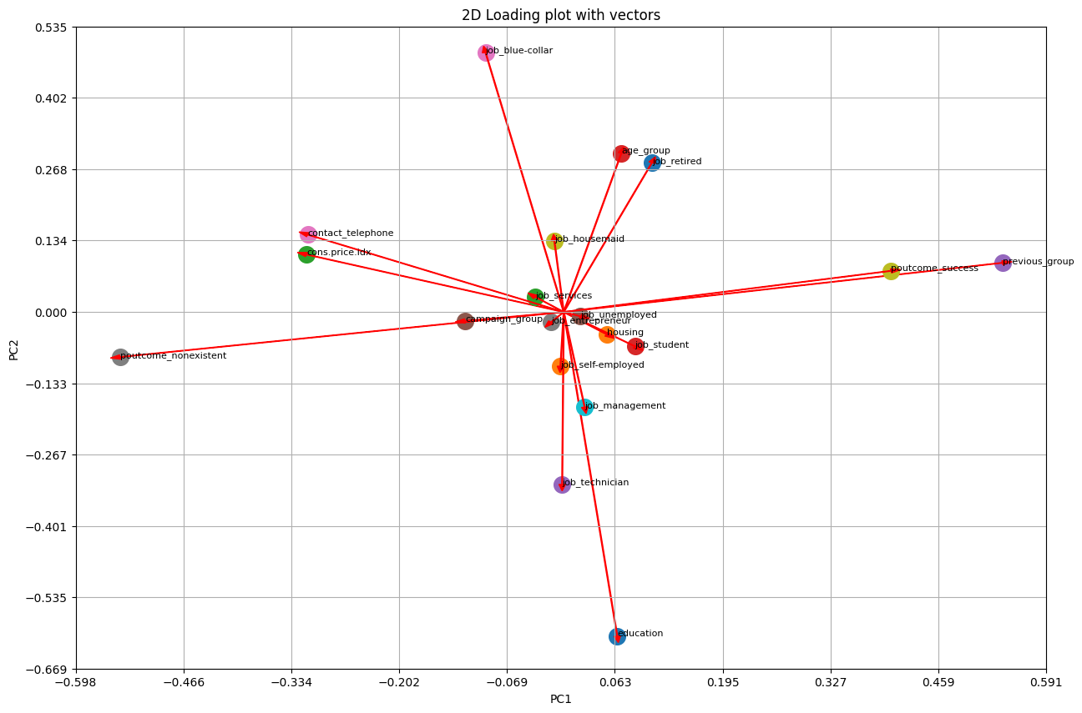
Important Variables
Age_group, job_retired, job_technician, job_blue-collar, education poutcome_nonexistent, poutcome_success and previuous_group hold the highest variance of the information.
In general, features are fairly orthogonal between each other and have large projections.

Slide 16
Table of contents
01
02
03
04
05
Introduction
Exploratory Data Analysis
Principal Component Analysis
Clustering Analysis
Conclusions

Slide 17
04
Clustering Analysis

Slide 18
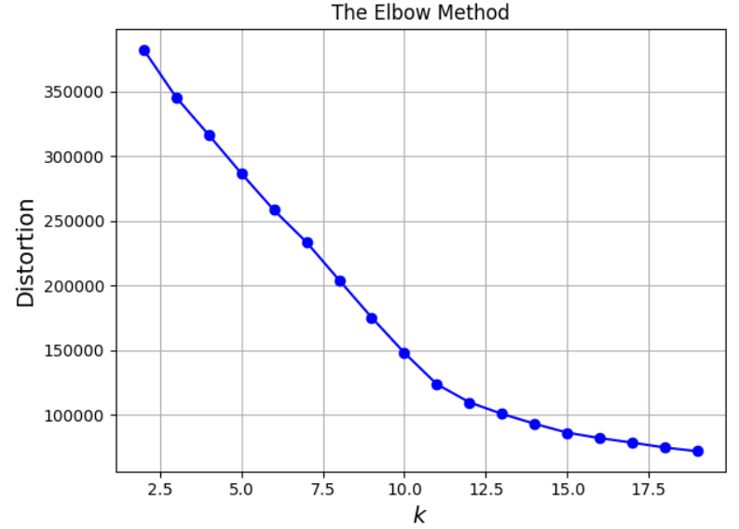
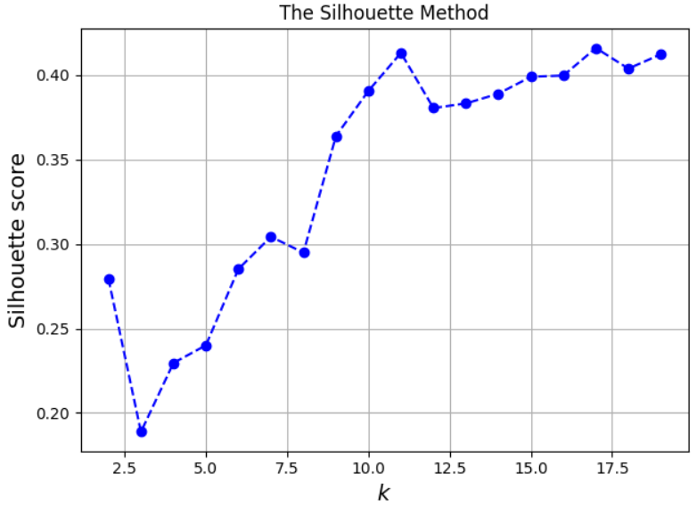

K-Means
Change in slope to indicate a potentially interesting number of clusters (11)
The higher the final coefficient, the more optimal the number of clusters (11)

Slide 19
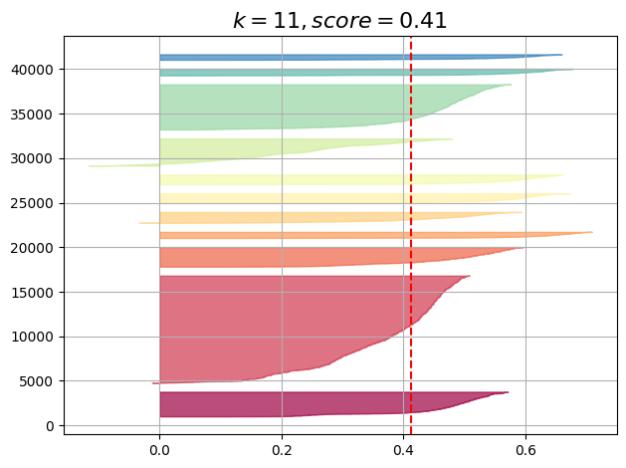
K-Means Silhouette Diagram
Measure how close each point in one cluster is to points in the neighboring clusters.
Clusters 2 and 9 exhibit the highest concentration of clients, thereby constituting the largest clusters. Clusters 1, 3, and 10 also manifest a significant aggregation of clients, whereas the remaining clusters are comparatively smaller and exhibit a degree of homogeneity.
The proximity measure for all clusters is approximately greater than 0.5, suggesting that the data points are substantially distant from those in neighboring clusters, a condition that is deemed favorable.
Cluster 3 may be considered the least favorable, as it demonstrates a negative skew and possesses the lowest silhouette score. Conversely, Cluster 7 is potentially the most favorable, denoted by its attainment of the highest silhouette score.

Slide 20
Cluster Distribution
1
5503
3
3961
9
5214
2
7509
10
2762
0
1260
5
1077
7
1183
4
687
8
728
6
604

Slide 21
Table of contents
01
02
03
04
05
Introduction
Exploratory Data Analysis
Principal Component Analysis
Clustering Analysis
Conclusions

Slide 22
05
Conclusions

Slide 23




Conclusions
PCA
Set of features containing majority of information variance
This technique minimized the dimensionality of the dataset while preserving the majority of its variance. As a result, the dataset became more straightforward to examine and visualize
Less dimensions conclude in better results
Clustering
Identification of 11 clusters
This technique enabled to divide the bank's customer base into discrete clusters. The bank might potentially increase the campaign's success rate by customizing its marketing techniques
Imbalanced distribution of observations

Slide 24
“Unsupervised learning is where you only have input data and no corresponding output labels. The system tries to learn without a teacher.”
Yann LeCun

